Slide 1
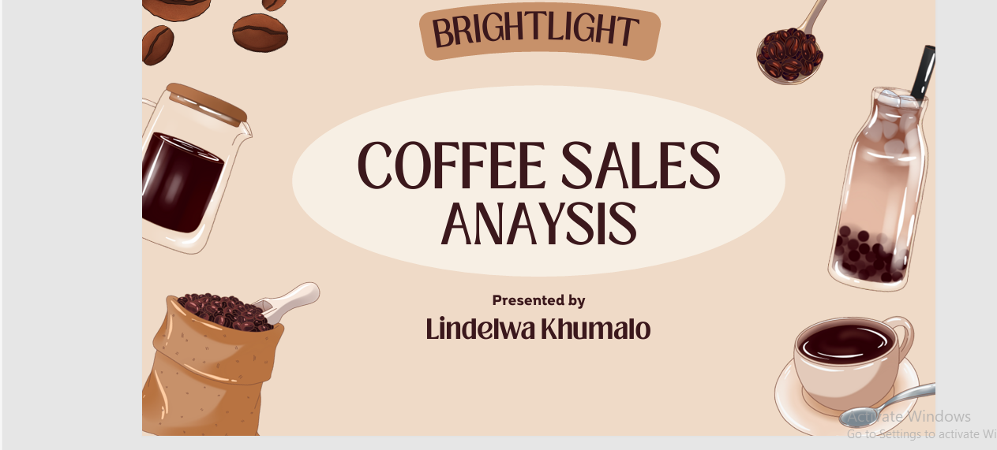

Slide 2
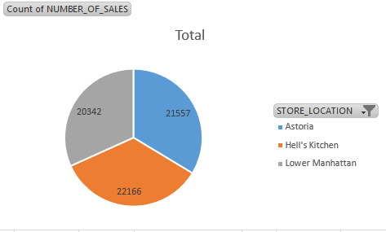
Store location by sales
This chart displays the distribution of total sales count across three store locations, with a combined total of 63,665 sales transactions.
Each location captures roughly one-third of total sales, suggesting fairly even market distribution or customer traffic across all three stores.

Slide 3
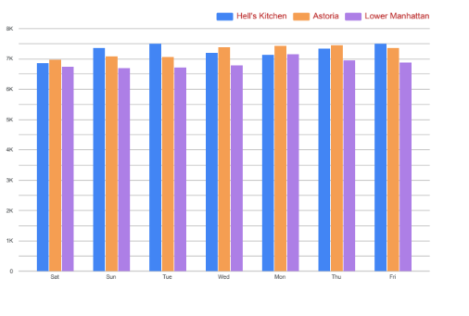
Store Location & Day Of The Week
All the location are doing quite well with high revenue exceeding 7k, however Hell’s kitchen takes the lead in revenue.
Lower Manhattan has the lowest in all the days of the weeks.

Slide 4
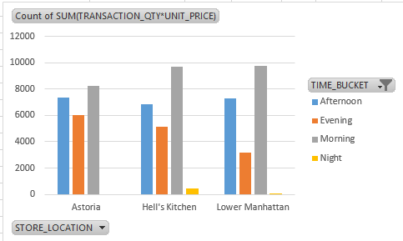
Store by time bucket
All three stores follow similar time-of-day patterns, suggesting consistent customer behavior across locations, with mornings being peak business hours.
Stores should ensure maximum staffing and inventory during morning hours, and might consider strategies to boost evening sales, particularly at Lower Manhattan.

Slide 5
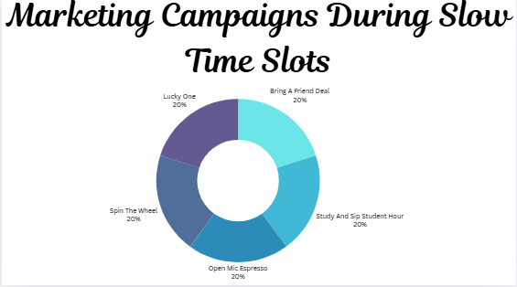
Marketing Campaigns During Slow Time Slots.

Slide 6
Marketing Campaigns During Slow Time Slots.
Education & Sampling
Offer free samples of coffee beans, loose tea, and flavored options
Host tasting events or "product of the week" promotions
Pricing Strategy
Review pricing—these items may be overpriced relative to customer expectations
Create loyalty rewards specifically for these categories
Marketing & Promotion
Run targeted promotions: "Buy 2 get 1 free" on packaged chocolates
Social media campaigns showcasing home brewing with coffee beans
Create gift sets combining tea, packaged chocolate, and branded merchandise
Create sales goals or competitions for promoting these items

Slide 7
Results

Slide 8
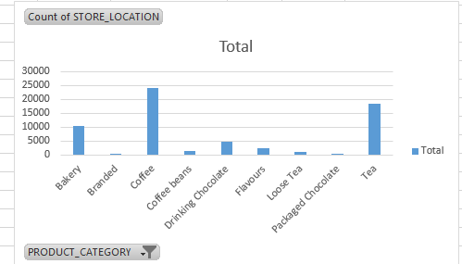
Stock best selling items
This chart displays the count of store locations by product category, showing which product categories have the most retail presence across the store network.
Coffee is clearly the core product driving store presence and packaged chocolate is the least.

Slide 9
Stock best selling items
Focusing on core beverage ingredients like espresso beans, milk, and sweeteners. Popular drink components such as ice, tea, and hot chocolate mix.
Essential disposable items like cups, lids, napkins and stirrers.
Food items keeping stock of popular pastries and baked goods for popular seasonal or promotional items.
Stock the ingredients for those as well, by tracking our sales data, we can identify which items are ,most popular and ensure those are well stocked, while also monitoring trends to stock seasonal specials effectively.

Slide 10
Conclusion
In conclusion this marketing campaigns were designed to target the slowest time slots and boost overall coffee shop performance.
The business demonstrates strong fundamentals with balanced location performance and predictable customer patterns.
The coffee-centric strategy has created wide market penetration, while maintaining operational consistency across locations.
The primary growth opportunities lie in optimizing underperforming time periods and potentially expanding strategic product categories where demand justifies broader distribution

Slide 11
END THANK YOU

